Slide 1
HNDIT2417
Mobile Application Development
Installing Android Studio

Slide 2
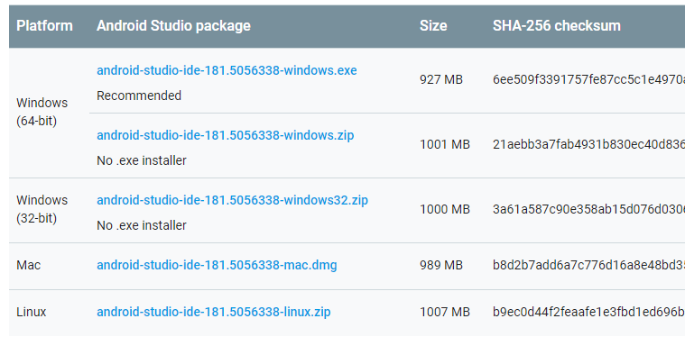
Android Studio downloads

Slide 3
Installing Android Studio
If you downloaded an .exe file (recommended), double-click to launch it.
If you downloaded a .zip file, unpack the ZIP, copy the android-studio folder into your Program Files folder, and then open the android-studio > bin folder and launch studio64.exe (for 64-bit machines) or studio.exe (for 32-bit machines).
Follow the setup wizard in Android Studio and install any SDK packages that it recommends.

Slide 4
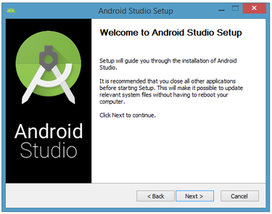
Installing Android Studio
Welcome dialog

Slide 5
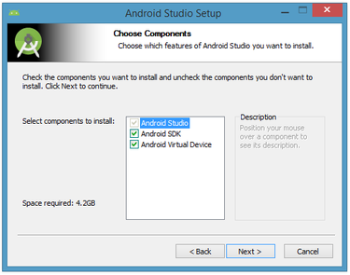
Installing Android Studio
Android SDK
Android Virtual Device (AVD).

Slide 6
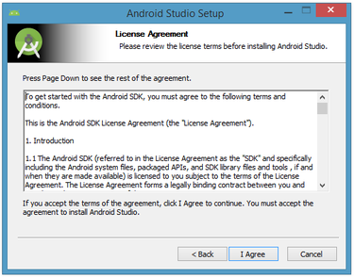
Installing Android Studio
License agreement dialog box

Slide 7
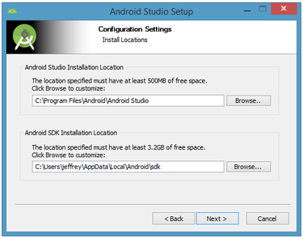
Installing Android Studio
Installation locations

Slide 8
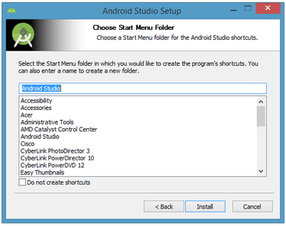
Installing Android Studio
Create the shortcut

Slide 9

Installing Android Studio
Splash

Slide 10
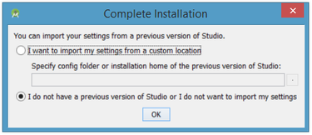
Installing Android Studio
Importing settings from any previously installed version of Android Studio.

Slide 11
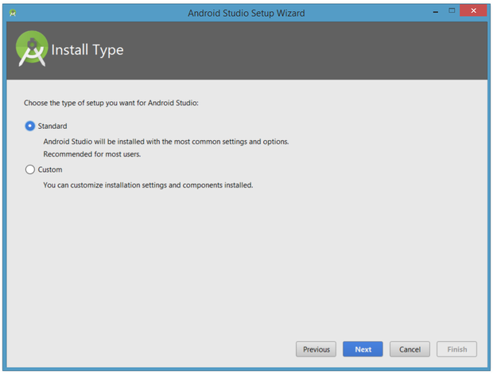
Installing Android Studio
Install type

Slide 12
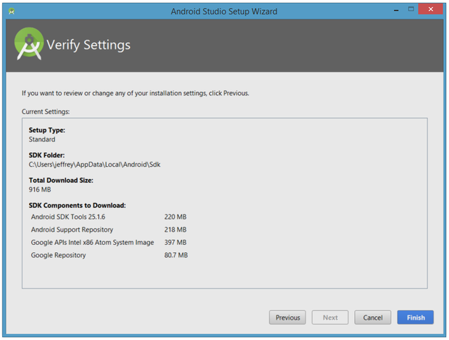
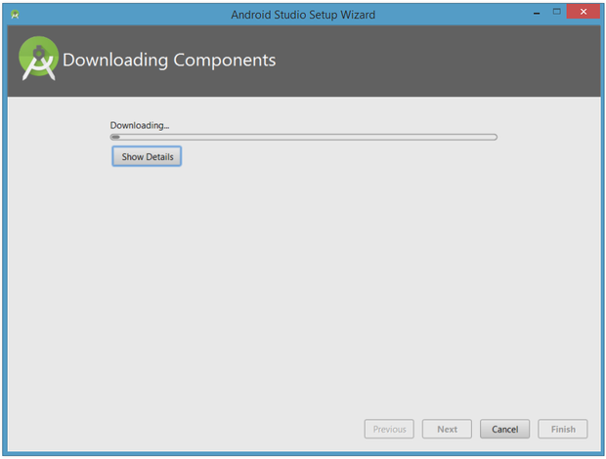
Installing Android Studio
Download and unzip various components.

Slide 13
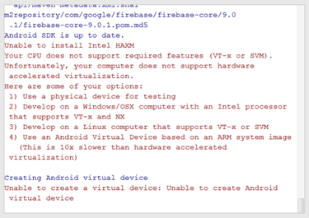
Installing Android Studio
If the computer isn't Intel based, following message will appear
  Unable to install Intel Hardware Accelerated Execution Manager (HAXM)
  Emulator will not run without HAXM

Slide 14
Android SDK
Android SDK is "the tool" for building and compiling android app, while Android Studio is the GUI tool (IDE) for "consuming" Android SDK. However, Android SDK can be run stand-alone (by using command-prompt), or with the other IDE like Eclipse

Slide 15
Android SDK
Set of development tools used to develop applications for Android platform. The Android SDK includes the following
Required libraries
Debugger
An emulator
Relevant documentation for the Android application program interfaces (APIs)
Sample source code
Tutorials for the Android OS

Slide 16
Android SDK
Developers must download and install each version’s SDK for the particular phone
Android SDK path on windows
C:\Users\Your.name\AppData\Local\Android\sdk

Slide 17
Java Development Kit (JDK)
Since Android applications are written in Java code, a user should have the Java Development Kit (JDK) installed.

